Slide 1

Introduction to Core Bluetooth
Understanding the Basics of Using Core Bluetooth
ChrisMarshallNY (Google-Friendly)
chris@RiftValleySoftware.com

Slide 2
BLUETOOTH CORE IS BIG
...CORE BLUETOOTH IS SMALL

Slide 3
Basic BLE Structure
CHARACTERISTIC
SERVICE
PERIPHERAL (Server)
CHARACTERISTIC
SERVICE
CHARACTERISTIC
CHARACTERISTIC

Slide 4



Basic BLE Structure
PERIPHERAL (Server)
SERVICE
SERVICE
CHARACTERISTIC
CHARACTERISTIC
CENTRAL (Client)
CHARACTERISTIC
CHARACTERISTIC
SERVICE
SERVICE
CHARACTERISTIC
CHARACTERISTIC
CHARACTERISTIC
CHARACTERISTIC

Slide 5




BLE Advertising: The Story of Dave and Matt

Slide 6



The Basic Structure Of Our Bluetooth Apps
CENTRAL
Bluetooth Magic 8-Ball
PERIPHERAL
(Client Behavior)
(Server Behavior)

Slide 7




The Basic Structure Of Our Bluetooth Apps
CENTRAL
PERIPHERAL
CBCentralManager
CBPeripheral
CBService
CBPeripheralManager
CBMutableCharacteristic
CBMutableService
CBCharacteristic
CBMutableCharacteristic
CBCharacteristic

Slide 8
The Basic Structure Of Our Bluetooth Apps
CBCentralManager
CENTRAL
PERIPHERAL
CBPeripheral
CBService
CBCentralManager
CBPeripheralManager
CBCharacteristic
CBPeripheral
CBMutableService
CBCharacteristic
CBService
CBMutableCharacteristic
CBPeripheral
CBPeripheralManager
CBCharacteristic
CBService
CBMutableCharacteristic
CBMutableService
CBCharacteristic
CBCharacteristic
CBMutableCharacteristic
CBCharacteristic
CBMutableCharacteristic

Slide 9
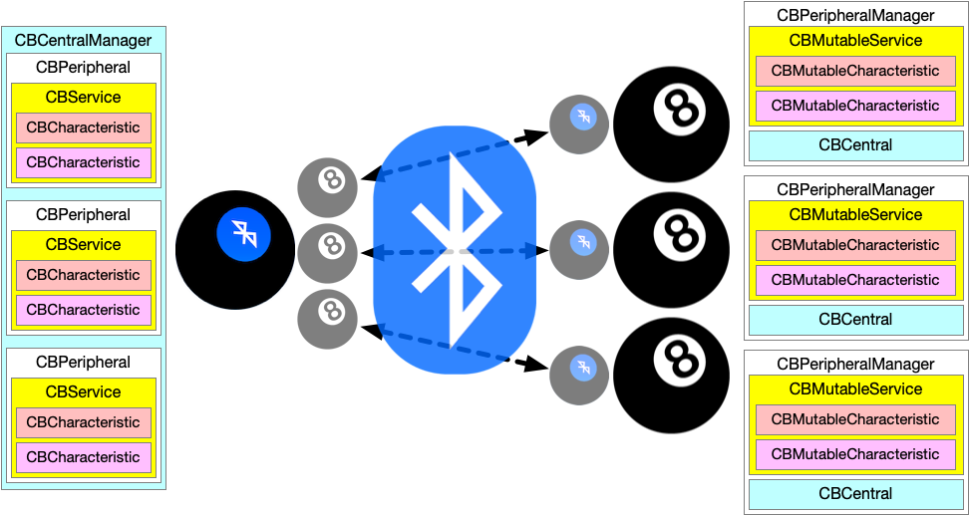
The Basic Structure Of Our Bluetooth Apps

Slide 10
LET’S CODE!

